Slide 1


Halloween Candy Tracker
A Smart Candy Inventory Management System
Deepika Gautam
Pratistha Prajapati
Nita Giri

Slide 2
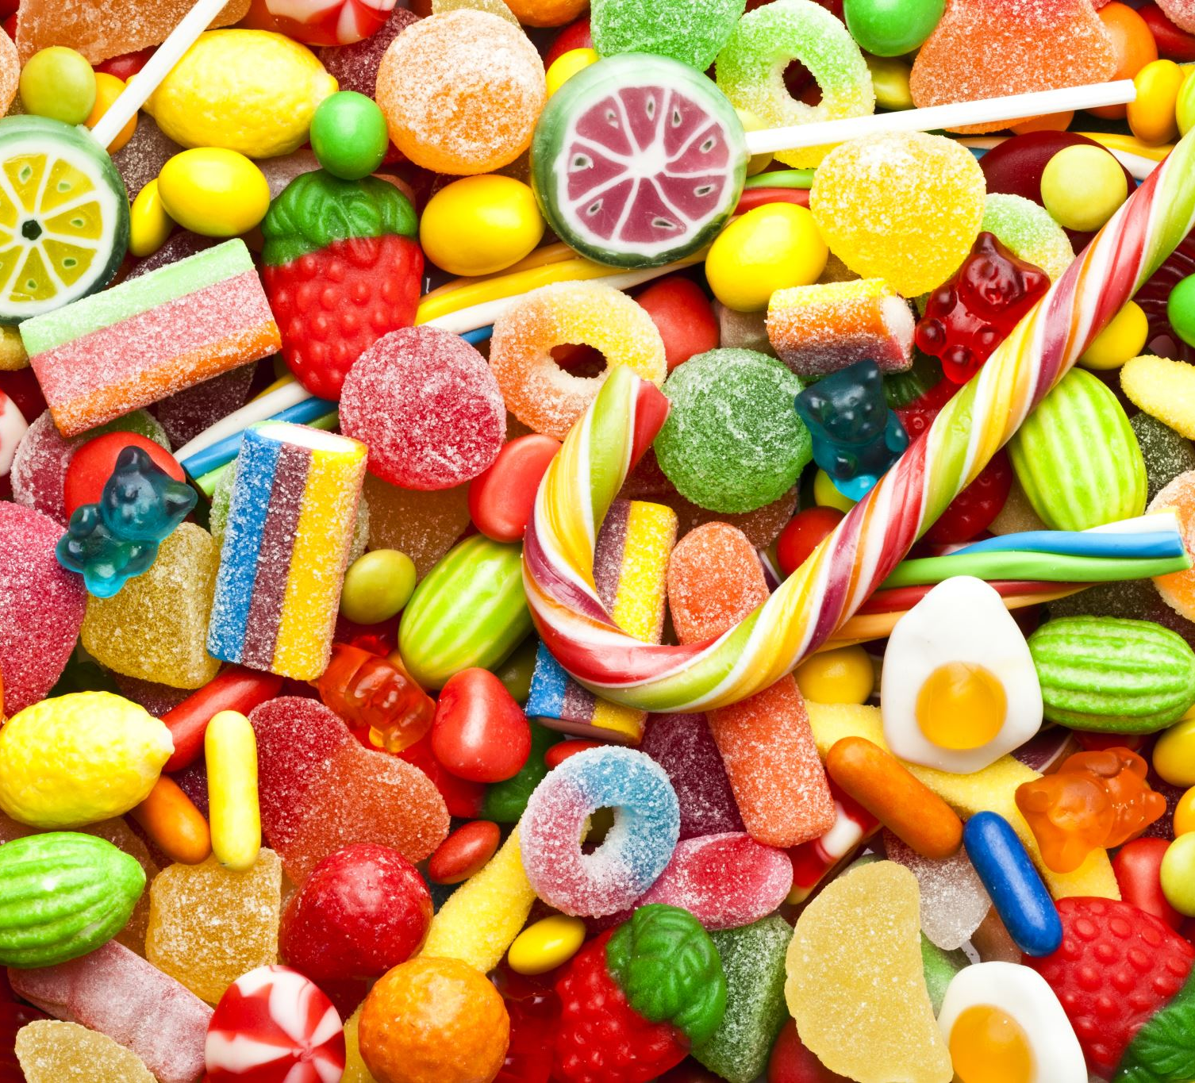
Happy Halloween
Every Halloween, it’s hard to keep track of how many candies have been given out or how many are left.
People often run out too soon or buy too much, wasting money.

Slide 3
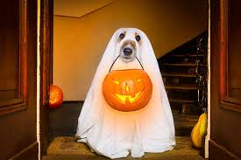
Objective
Build an interactive web system to track candy distribution and remaining stock in real time.
Users can select candies they receive
The system automatically updates the total candy count.
Admins can view current inventory anytime.

Slide 4
System Overview
User Interface (index.html)
App.py (read / write)
candies.csv (Data Storage)
Frontend: HTML, CSS, JS (user interactions)
Backend: Fast API (handles updates) , Python
Data: CSV file stores candy stock

Slide 5
Features
Track how many candies are taken
Display live candy stock on admin page
Separate admin and user pages
Smooth UI with Halloween theme
Real time backend updates using Flask

Slide 6
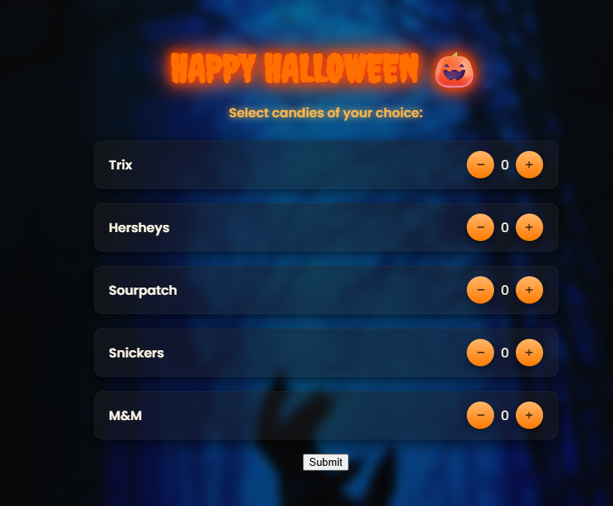
Demo Screenshots – For trick or treaters

Slide 7
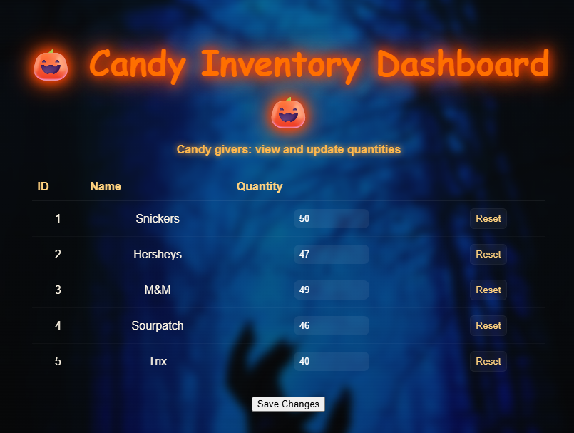
For admin

Slide 8
Real World Application
Inventory systems in small stores 🏪
POS (Point-of-Sale) systems in restaurants 🍔
Event giveaway trackers 🎟️

Slide 9
Learning Outcomes
Frontend–Backend Integration
Working with APIs and Fetch
Data management using CSV
Fast API web development
Team collaboration & debugging

Slide 10

Future Enhancements
🚀 Add login system (Admin authentication)
📊 Replace CSV with database (SQLite/MySQL)
📈 Add data visualization charts
📬 Add email/SMS alerts for low stock
☁️ Deploy online for public access

Slide 11

Conclusion
The Halloween Candy Tracker simplifies candy distribution, provides live stock updates, and demonstrates real-world inventory tracking principles in a fun, themed way.

Slide 12
Thank You!
Thank you to all the mentors, William, Joshua, Brandon, Abdi!
It couldn’t have been possible without them at all and they know it.
Also, a sincere thank you to Mr. Issac Oslon for presenting us with this opportunity.

Slide 13
Thank You!
Candies Please

